Slide 1
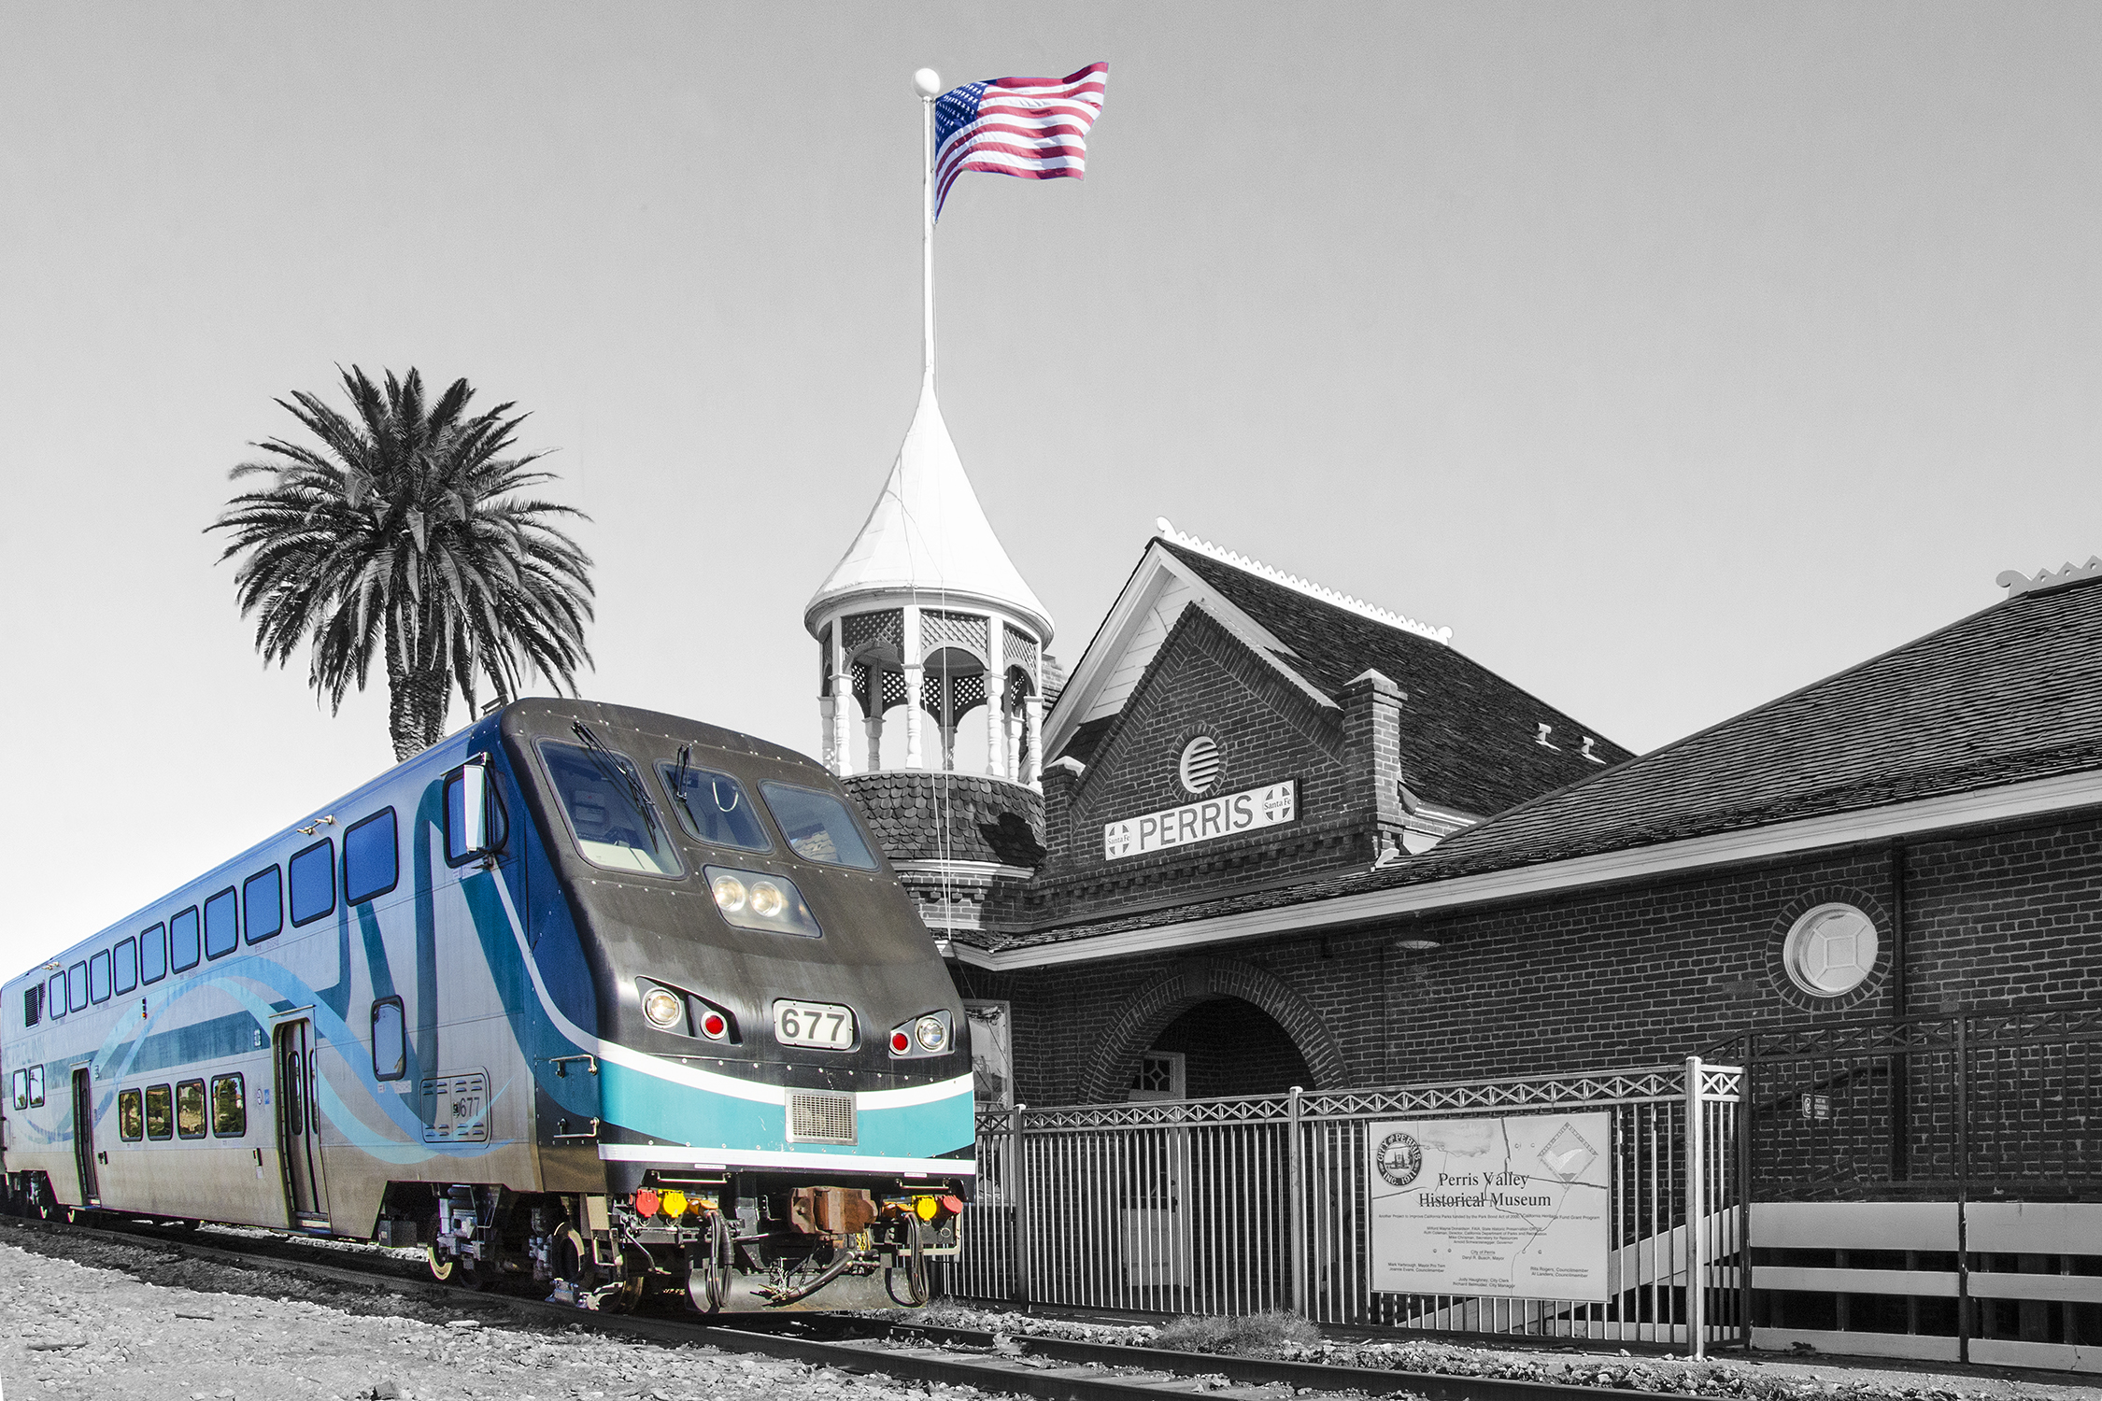
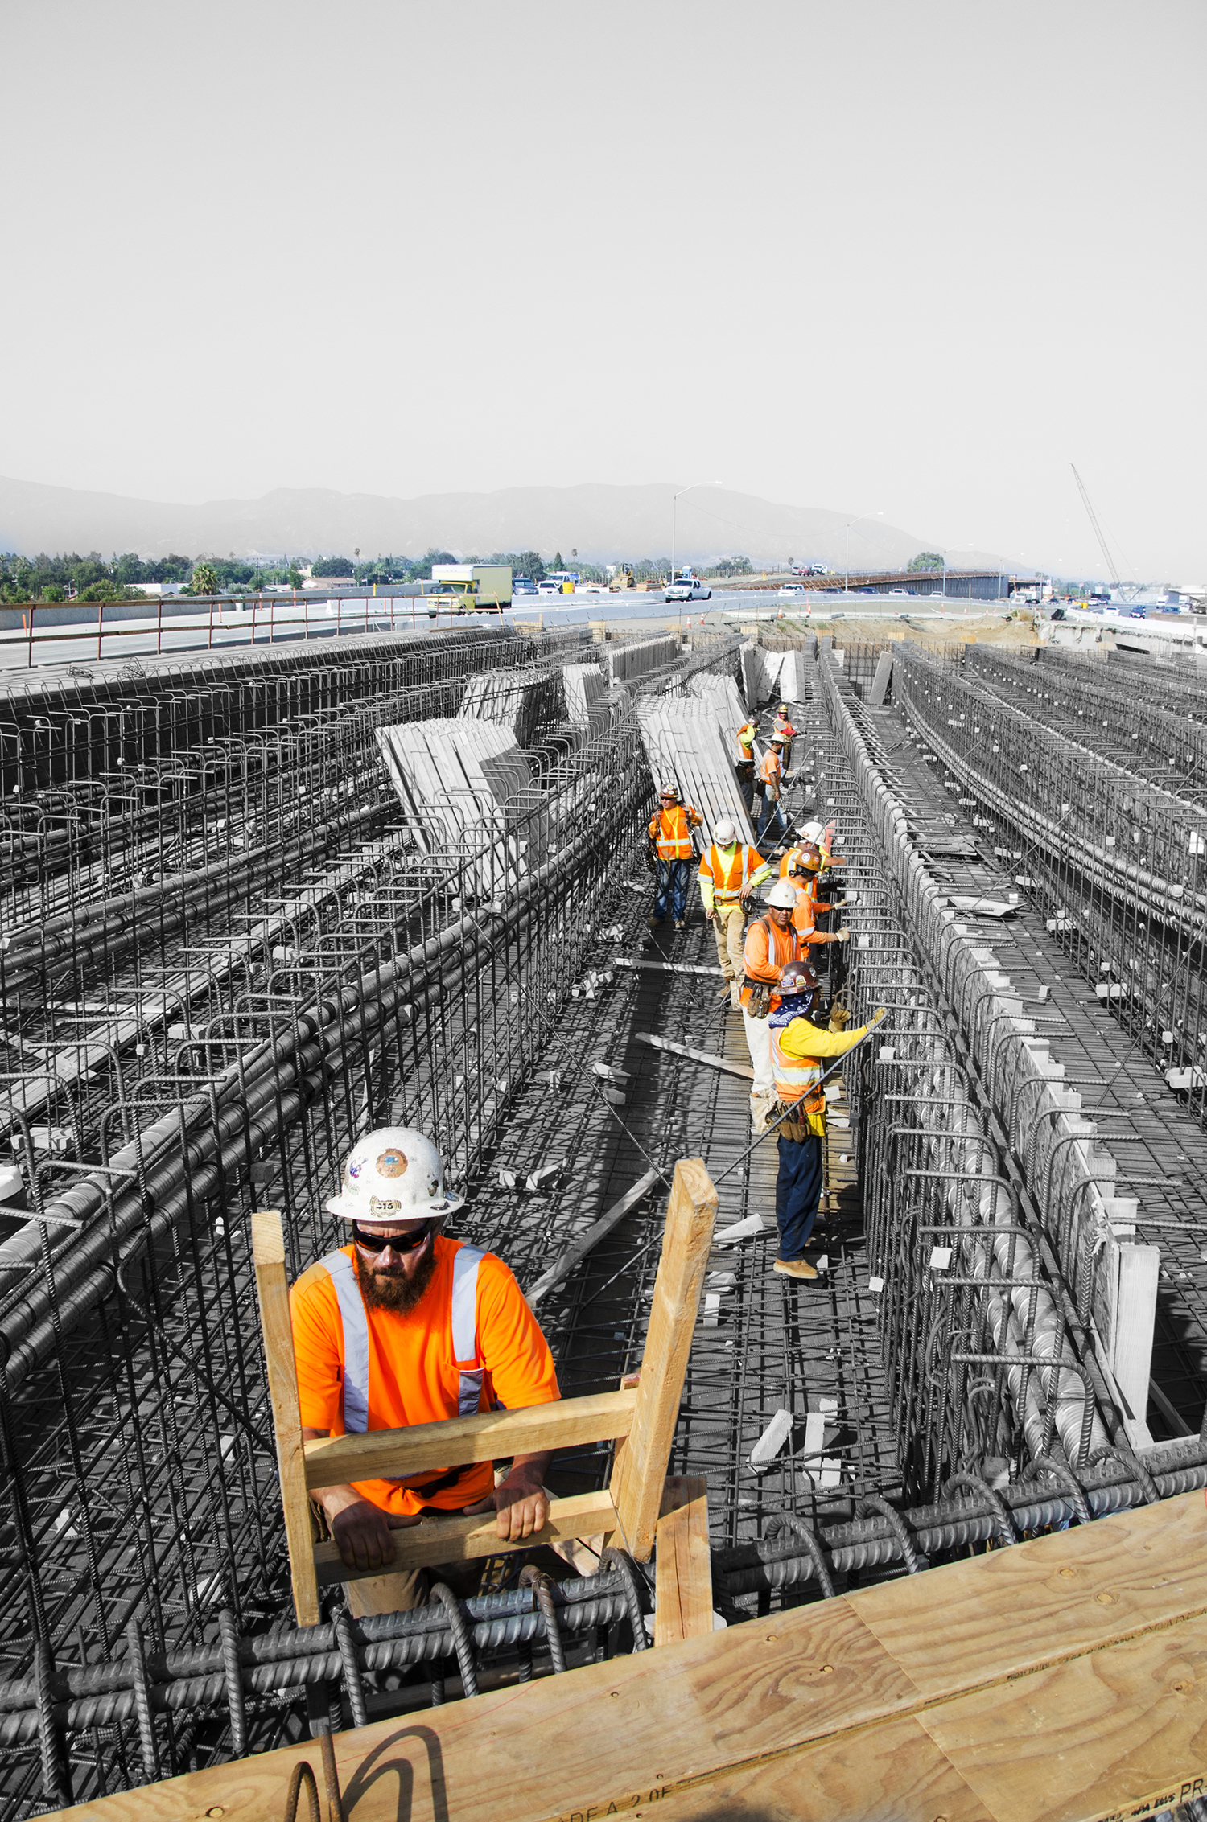
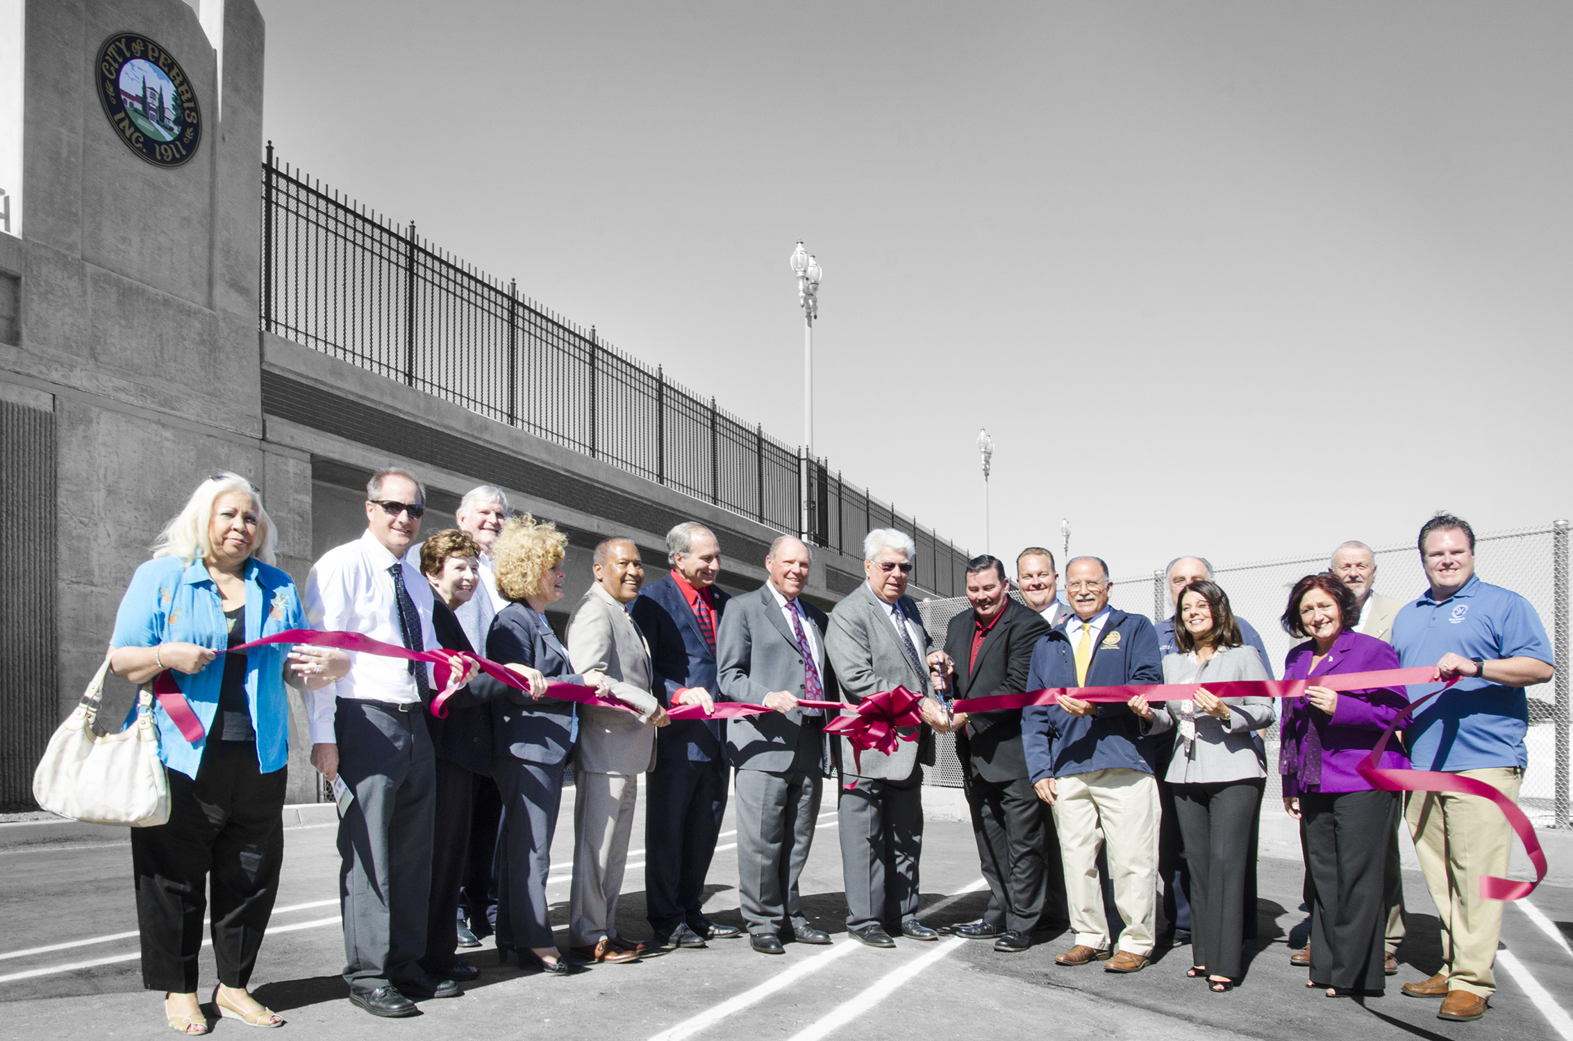
Welcome to RCTC February 3, 2017

Slide 2
Where it All Started
Created by State law in 1976 along with similar agencies in neighboring counties
Subsequent amendment in 1998 expanded the Commission
Codes cover areas of responsibility and administration
Responsible for state highway coordination and short range transit plans
Authorization to seek voter approval of sales tax

Slide 3
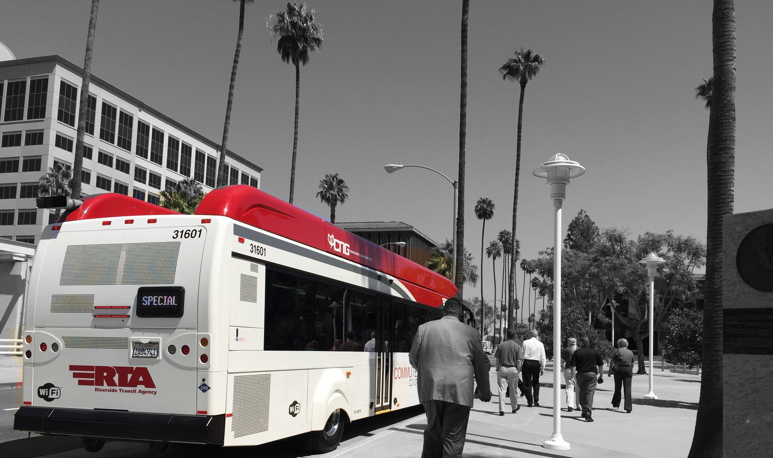
Original Responsibilities
Coordinate state highway planning
Adopt Short Range Transit Plans
Coordinate transit service
Identify projects for state and federal funding
Coordinate county plans with state and regional agencies

Slide 4
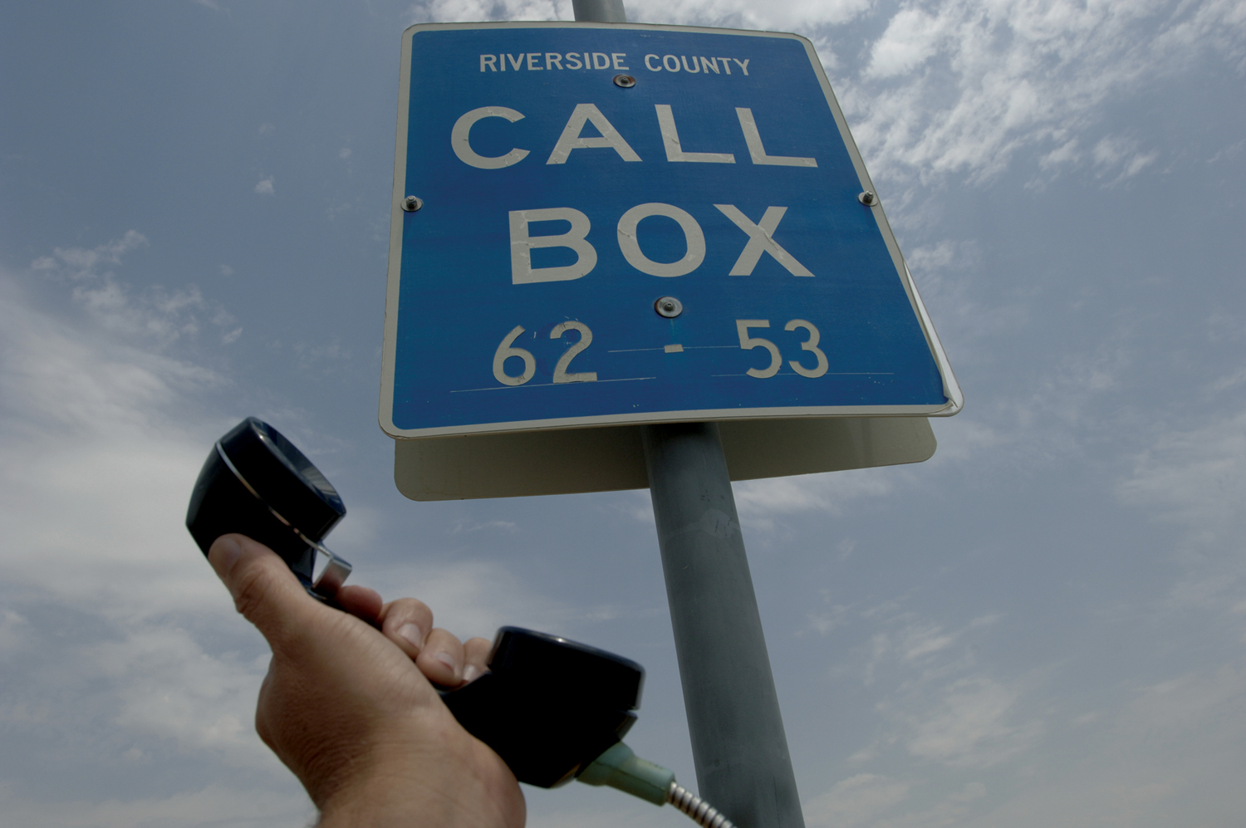
Added Responsibilities
SB 45 – Local control over state funding
SAFE – Call Boxes & Freeway Service Patrol
Self-Help county provisions and Measure A

Slide 5
Measure A
Approved by two-thirds margin in 1988 and 2002
Governed by expenditure plans
Genesis of TUMF programs
Establishes geographic return-to-source provision

Slide 6
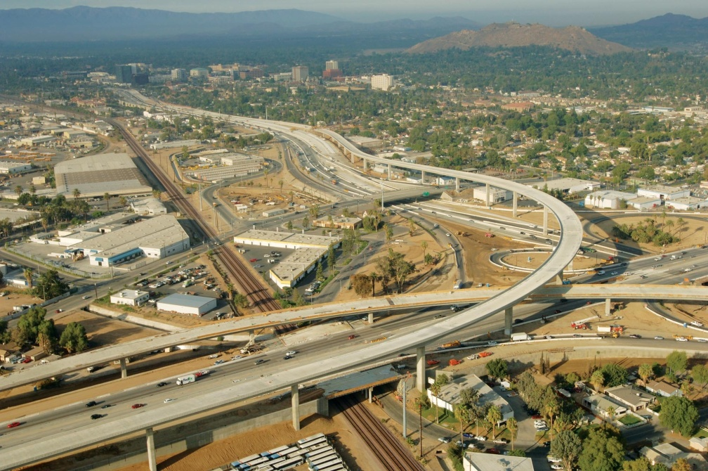
Measure Accomplishments
Widened routes 60, 74, 79, 86 & 91, I-215
Built interchanges throughout the county
Funded arterial projects countywide
Launched and operate Metrolink service
Grade separation projects
Returned more than half a billion dollars to cities and the county

Slide 7
Measure A Projects
Western County Expenditure Plan funds:
State highways
New transportation corridors (With TUMF Funding)
Regional arterials (With TUMF Funding)
Local streets and roads
Public transit
Economic development incentives
Debt financing costs

Slide 8
Measure A Projects
Coachella Valley Expenditure Plan Funds
State highways and major regional roads
Local streets and roads
Public transit
Palo Verde Valley Expenditure Plan unds
Local streets and roads

Slide 9
Partnering Agencies
RCTC works with other partners including:
Caltrans
California Transportation Commission
Planning agencies/COGs
Transit providers
Resource agencies
Cities & the county
Neighboring agencies

Slide 10
Commission Structure

Slide 11
Commission Structure
Legislation mandates composition, voting structure and certain committees
Each city appoints one member and an alternate
Commission’s Administrative Code creates standing committees
Commissioners also represent RCTC on boards of other agencies

Slide 12
Commission Staff
We’re here to help:
Anne Mayer, Executive Director amayer@rctc.org
John Standiford, Deputy Executive Director jstandiford@rctc.org
Jennifer Harmon, Clerk of the Board jharmon@rctc.org
Office telephone number: (951) 787-7141

Slide 13
Social Media
@RCTC
@theRCTC

