Slide 1

Larry Rubio
Chief Executive Officer
Riverside Transit Agency

Slide 2
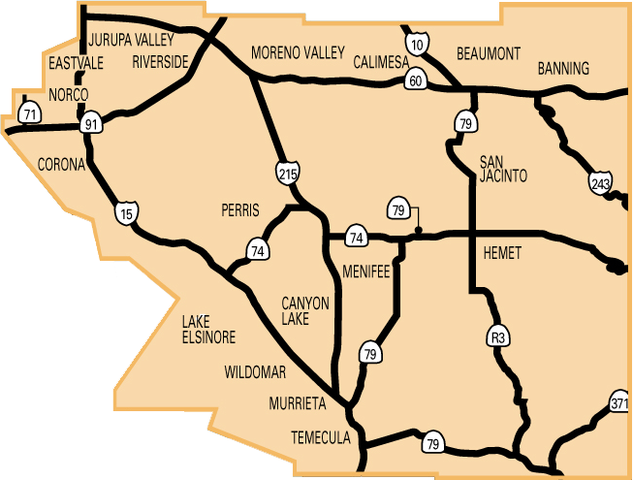
Riverside Transit Agency
Established as a Joint Powers Agreement on August 15, 1975
Service began on March 16, 1977
Service area: 2,500 square miles of Western Riverside County.
18 cities and Supervisorial Districts I, II, III, V

Slide 3
Member Jurisdictions
City of Banning
City of Beaumont
City of Calimesa
City of Canyon Lake
City of Corona
City of Eastvale
City of Hemet
City of Jurupa Valley
City of Lake Elsinore
City of Menifee
City of Moreno Valley
City of Murrieta
City of Norco
City of Perris
City of Riverside
City of San Jacinto
City of Temecula
City of Wildomar
County of Riverside District 1
County of Riverside District 2
County of Riverside District 3
County of Riverside District 5

Slide 4
Fiscal Year 2017 Budget
Operating Capital
Local Transportation Fund $44,449,217 $(3,698,701)
Federal Transportation Admin $15,503,861 $9,980,607
State Transportation Assistance $0 $2,164,572
Passenger Fares $11,050,000 $0
Measure A $2,845,122 $0
TUMF $0 $0
Other $2,415,510 $5,191,233 Total $76,263,710 $13,637,711

Slide 5
RTA Locations
Riverside
Hemet
Contractor Locations
Perris
  - Empire Transportation | Fixed Route
  - TransDev | Dial-A-Ride
Provide 900 Jobs
464 directly employed
436 contract employees

Slide 6
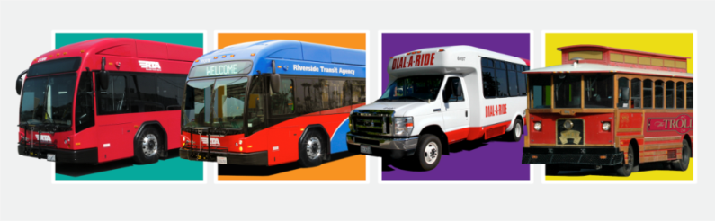
Bus Fleet
224 Fixed route buses
104 Dial-A-Ride buses
328

Slide 7



Bus Features
Compressed Natural Gas (CNG) buses
Automated stop announcing system
GPS location monitoring
USB charging ports
Free WiFi
Dual bike racks
100% wheelchair accessible
Electronic fareboxes
Security cameras
Notes:
Bus features

Slide 8
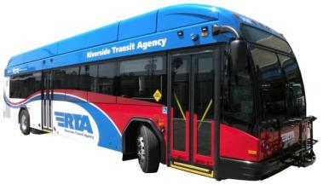
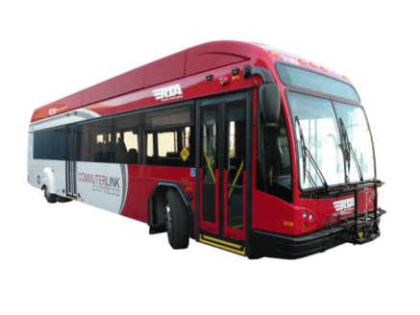
Fixed Route Bus Service
  36 Local fixed routes
      8 Commuter Routes
      Riverside County
      Orange County
      San Diego County
      San Bernardino County

Slide 9
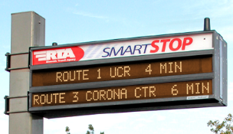
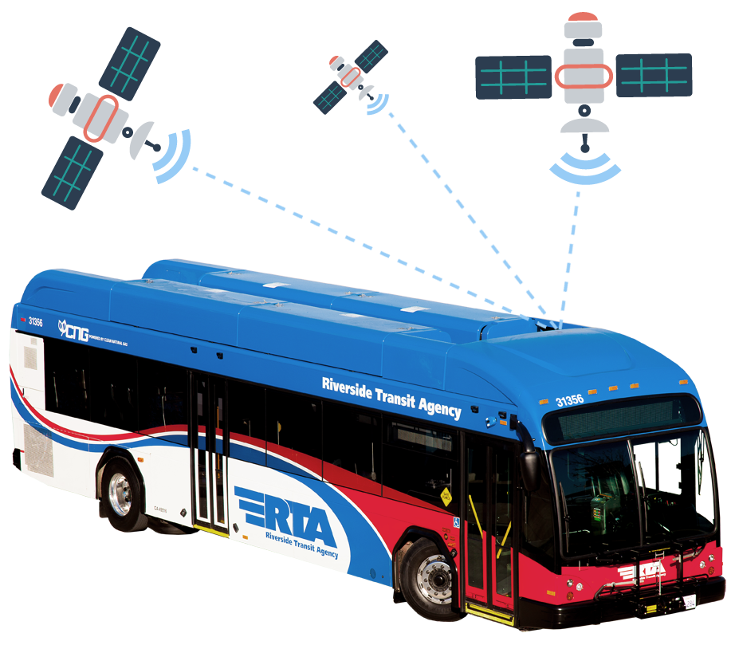
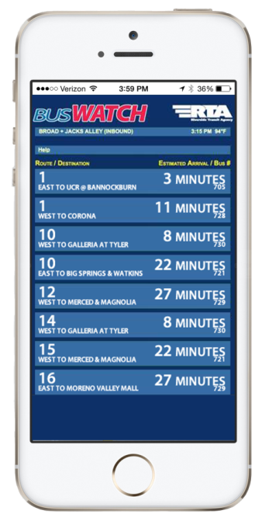
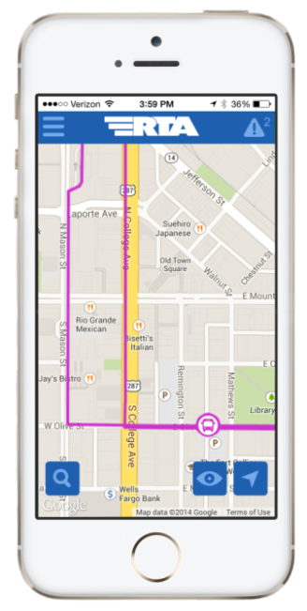
Advanced Traveler Information System

Slide 10
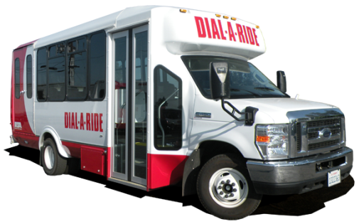
Dial-A-Ride Service
  Curb-to-curb, advanced reservation service for seniors age 65 and above and persons with disabilities.
Partner with:
City of Riverside
Corona Cruiser
Pass Transit
Other senior/disabled services

Slide 11
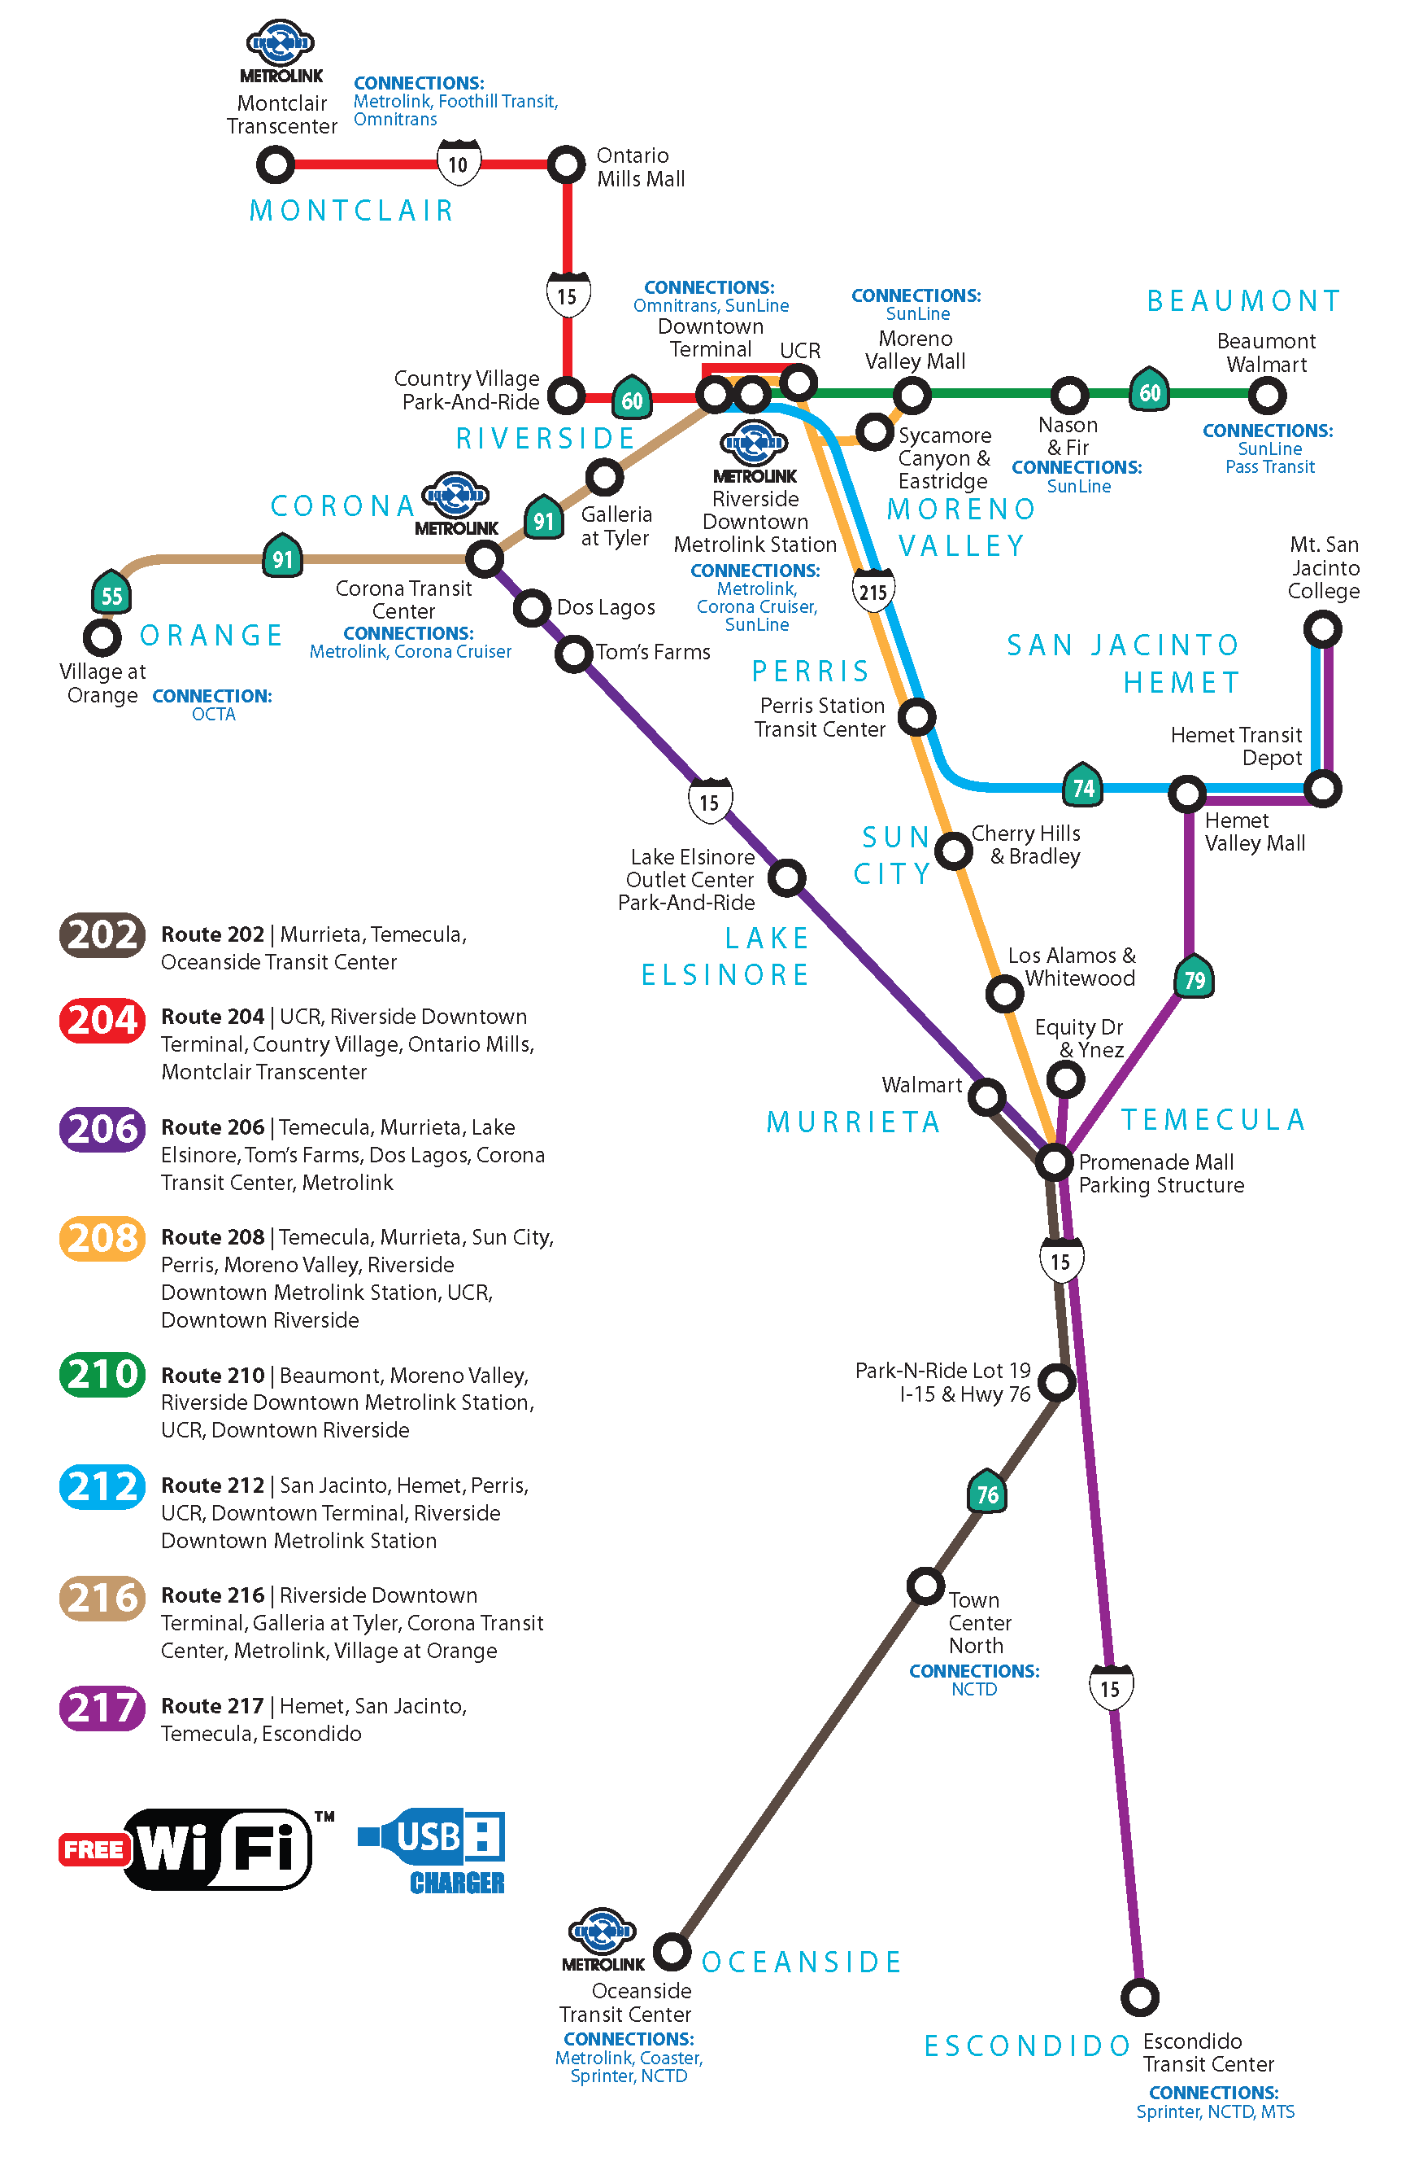


Slide 12
CommuterLink Passenger Amenities
  Upgraded padded seating
  Luggage racks
  Reading lights

Slide 13
Interfacing with Metrolink
CommuterLink and local buses meet Metrolink trains
Metrolink customers ride free
Metrolink reimburses RTA for free rides
Reduces parking demands at stations

Slide 14

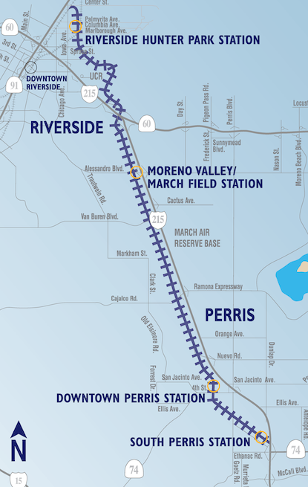
Four new stations
RTA buses meet all Metrolink trains
  13 routes total
  2 new routes

Slide 15

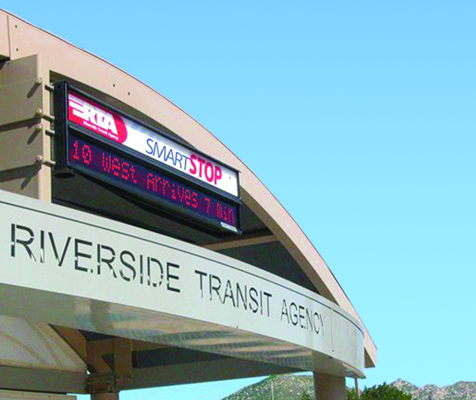
Bus Stops
2,500+ bus stops
Computerized real-time arrival information at select stops
Maps and schedules at most stops
Solar-powered i-Stops at select stops

Slide 16
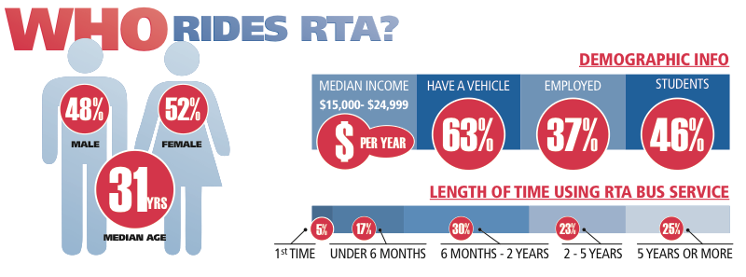

Slide 17
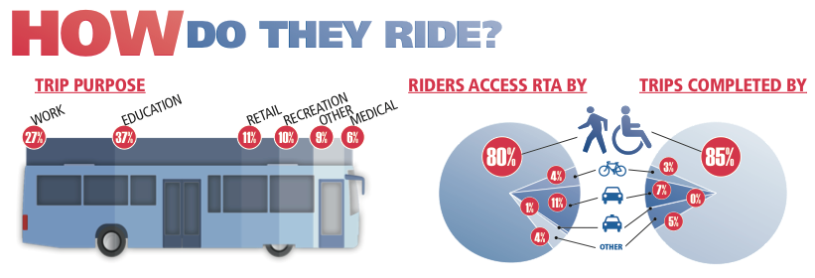

Slide 18
Public Schools K-12
14 school districts served
113 middle and high schools served
Youth pass discounts
Coordinate schedules with bell times
Classroom presentations
Classroom art and video contests
Webpage developed

Slide 19
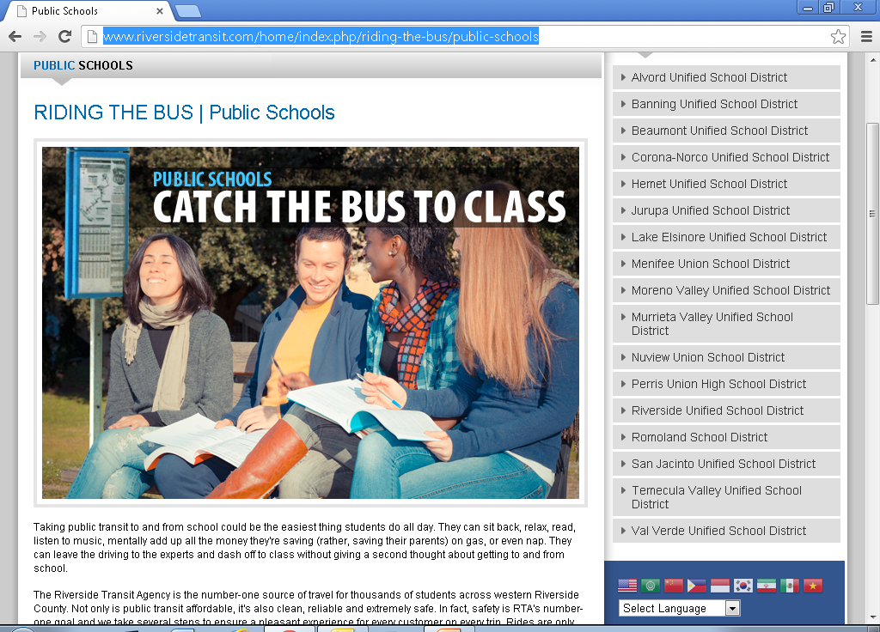
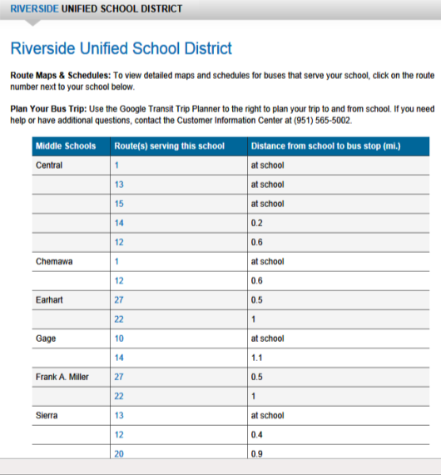
Public Schools Interactive Webpage

Slide 20




Student/Employee Ride Programs
CY16 Ridership
University of Cal, Riverside 407,343
Cal Baptist University 46,886
La Sierra University 5,394
Riverside City College 537,339
Moreno Valley College 128,425
Mt. San Jacinto College 198,918
Norco College (Joined Fall 2016) 32,047
City of Riverside Employees 11,699
Riverside County Jurors 4,847

Slide 21
Student Ridership
2016
                Number of Percent of Eligible
                Student Riders Student Body
Cal Baptist University 1,096 8%
La Sierra University N/A N/A
Moreno Valley College 2,104 22%
Mt. San Jacinto College 3,285 12%
Norco College (Joined Fall 2016) 645 10%
Riverside City College 7,213 23%
UC Riverside 11,206 28%

Slide 22
Other Ride Programs
City of Riverside Employees
Riverside County Jurors

Slide 23




Pass discounts for Riverside residents

Slide 24

Business Partnerships
Bus pass good for discounts at local businesses including
    Fix It Cell Repair
    Marcello’s Pizza
    Moreno Valley Flower Box
    Shakey’s Pizza
    White’s Bikes
    Many others…

Slide 25

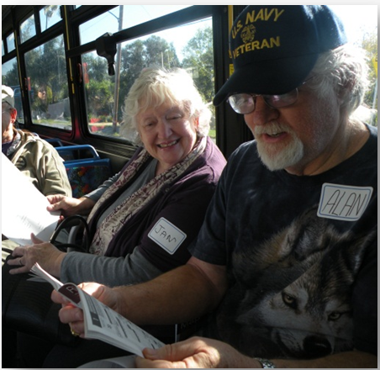
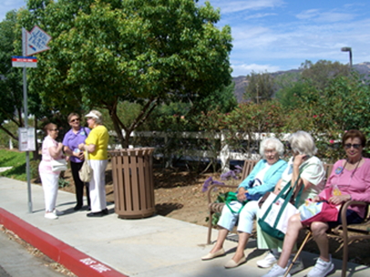
Travel Training Program
  Senior Ambassadors/Group
  Travel Training/One-on-one
  Disabled & Veteran outreach

Slide 26

Comprehensive Operational Analysis
18-month study
Ten-year blueprint for operations & capital
Rider and non-rider surveys
Aligned with
  Transit center projects
  SR-91 Corridor Improvement
  Perris Valley Line
  Future High Speed Rail

Slide 27
What We Did
Improved frequencies
Timed transfer connections
Later service hours
Improved amenities
Shortened travel times
Maintain lifeline transit coverage

Slide 28
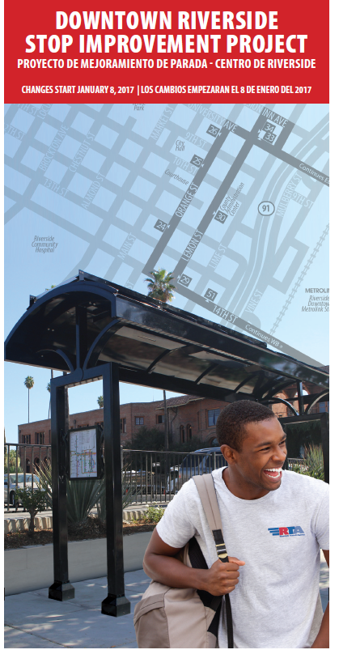
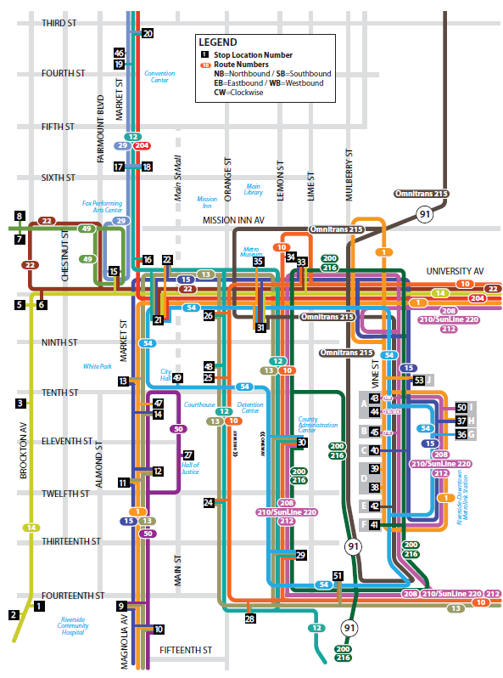

Slide 29
Implementation Strategies
Communication
  Branded
  Ambassadors
  Customer Information Clerks
  Travel trainers
  Administrative staff
  Coach operators
  Security guards at Vine Street
Updates via website, iAlerts & social media
BusWatch

Slide 30
Outreach Summary Pre-Change
  October to January 7
  Stakeholder meetings
  Outreach at Moreno Valley Mall, Galleria at Tyler, Perris Transit Center and the Riverside Downtown Terminal
  One-on-one trip planning and assistance
  Training ambassadors, coach operators & contractors
  Number of pre-change outreach efforts: 36
  Total staff hours: 762
Notes:
At the end of the first week we logged in a total of two formal complaints. That’s unheard of in this business.

Slide 31
Ambassador Outreach Program
Post-Change
 | Week 1 | Week 2 | Week 3
Hours | 4 a.m. – 6 p.m. | 6 a.m. – 6 p.m. | 7 a.m. – 5:30 p.m.
Ambassadors Available | 90 | 58 | 26
Ambassadors Deployed at all Times | 19 | 7 | 5
Ambassador Hours | 1,243 | 431 | 226

Slide 32
Vine Street Mobility Hub
2.37 acres – City Owned
0.80 acres – RPU Water Well
1.50 acres – RCTC Parking

Slide 33
RapidLink GoldLine
UCR to Corona via Downtown Riverside
Preparing the corridor for frequency improvements
Improvement of major stops
Design & planning
Launch Fall 2017

Slide 34
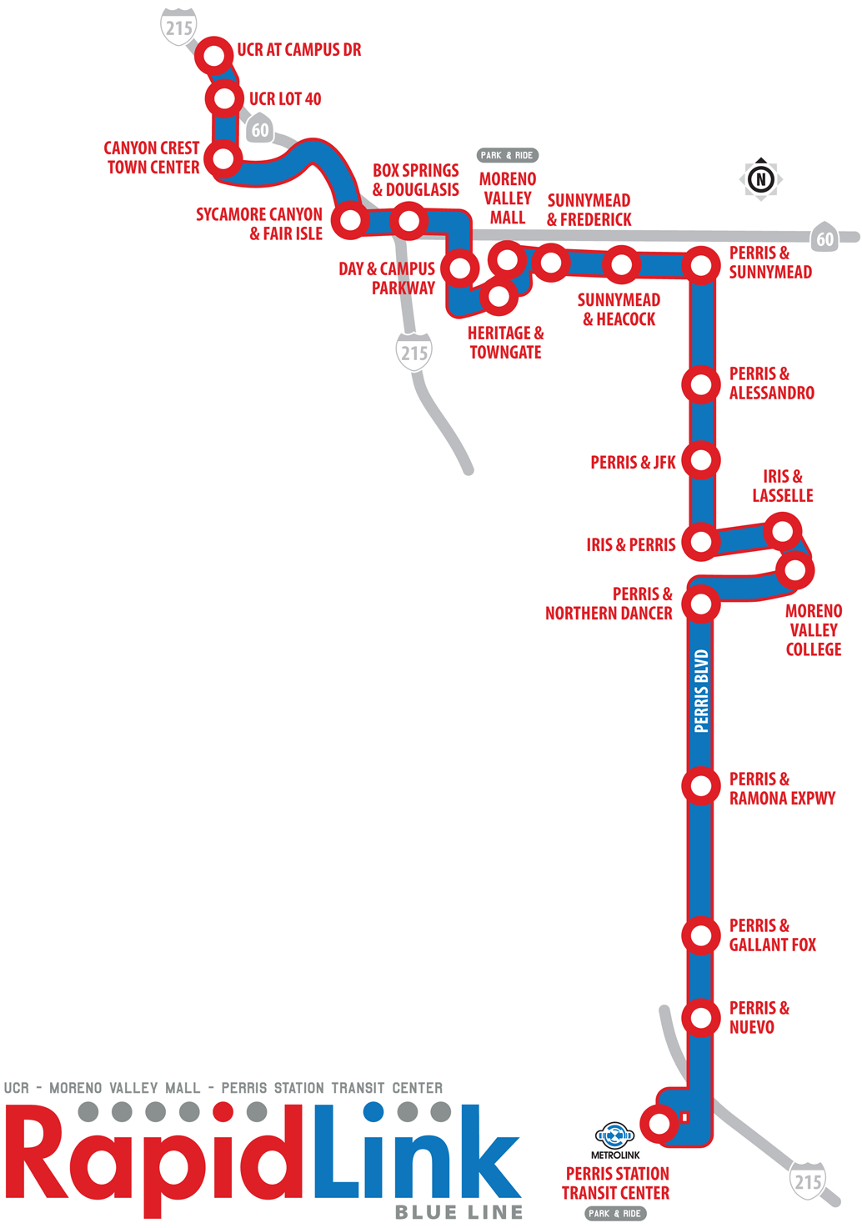
RapidLink BlueLine UCR to Perris via
Moreno Valley
Preparing the corridor for frequency improvements
Improvement of major stops
Design phase
Developing funding strategy

Slide 35
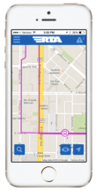


Coming in 2017
  40th Anniversary – March 16
  Mobile App
  RapidLink GoldLine
  California Transit Association Fall Conference

Slide 36
Thank You!

